Slide 1

Airport Restaurant SQL Report
Shaun Pritchard - Module 3 - QMB4000
Full Code atached in asignment jupyter notebook

Slide 2
Key Points
We will be looking at Airport restaurant dataset to find correlations and trends based requested by the CEO to answer these questions:
Minimum number of violations per year for each airport
Maximum number of violations per airport
What violations each cuisine has incurred.
Which restaurants per airport hade more violations
Which airports hade more violations per month
Which Business has the best average grade

Slide 3
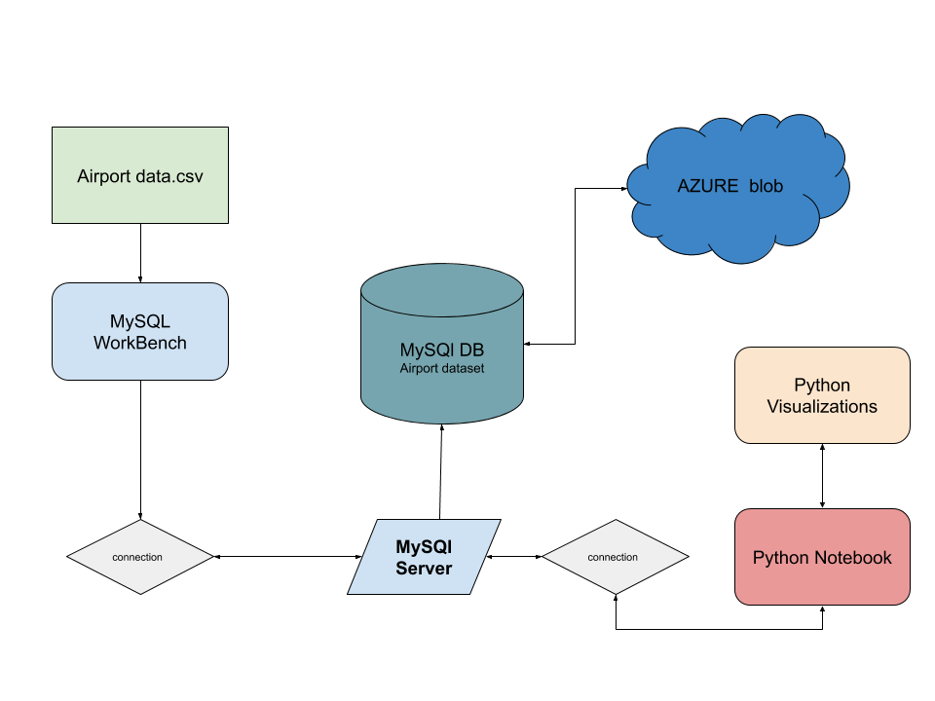
Technology Stack
In this project I used serval technologies to load the data into a local MySQL database server. Managed with MySQL Workbench. Implemented visualizations with Python directly from the database using MySQL connect, and ten pushed to the cloud Azure blob Sql storage.

Slide 4
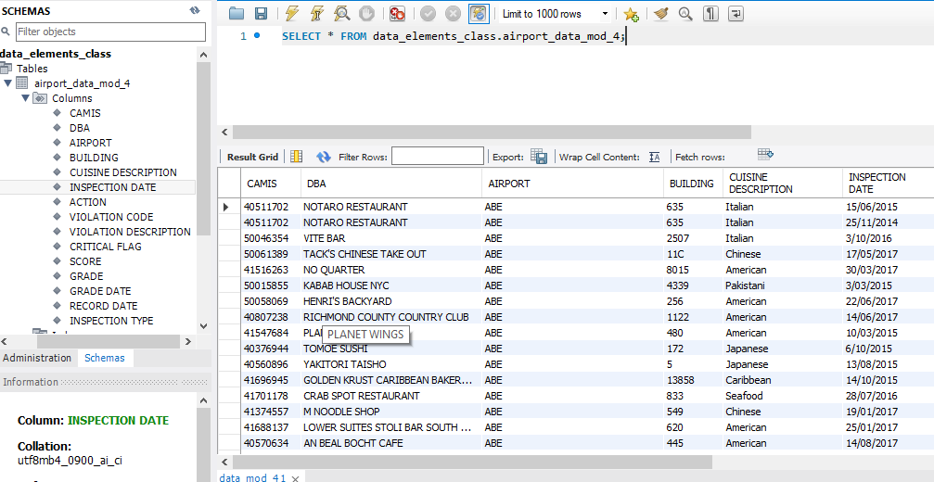
MySQL Workbench
Imported csv data created a schema and table for all the data.

Slide 5
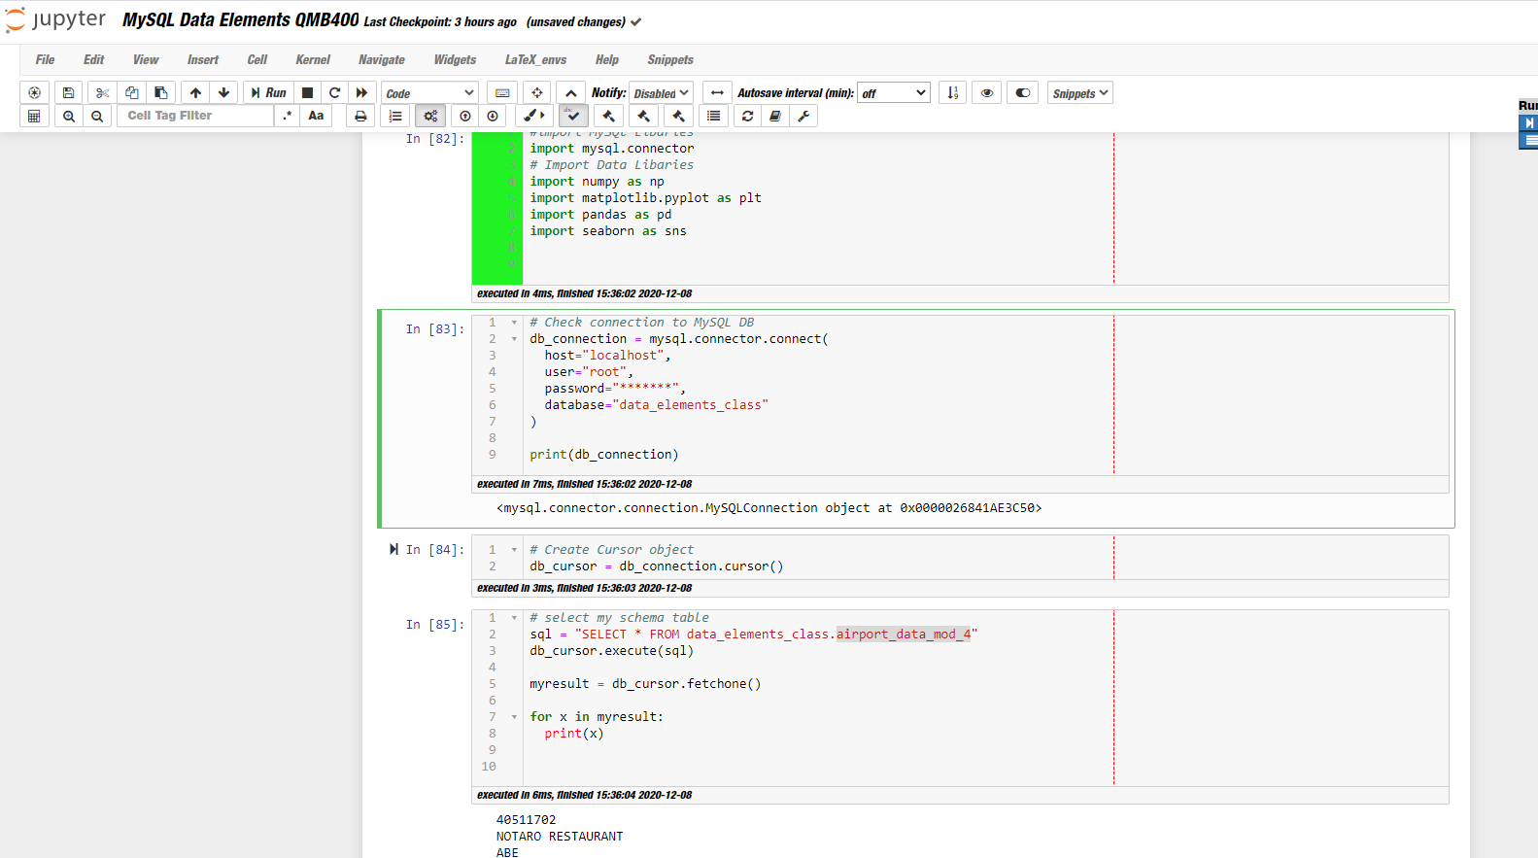
Python workflow
Connected to MySQL database server to run inferences on data.

Slide 6
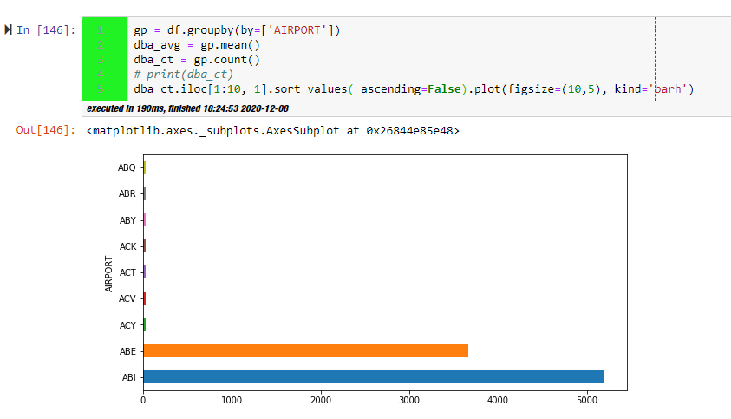

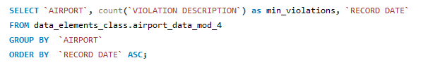

Q1. Minimum number of violations per year for each airport
Data Results
Number of violation records
Code:
Based on the data report the WED airport has 9 violations. My visual could only handle 15 results the number of violations for WED was too low in 2017

Slide 7
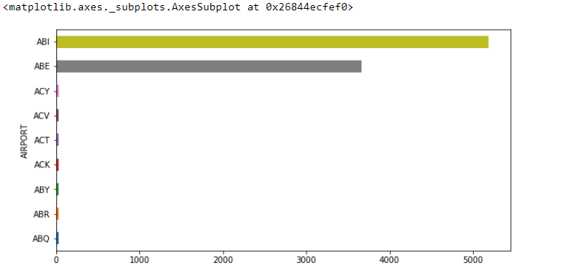
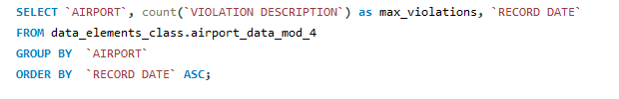

Q1. Maximum number of violations per year for each airport
Data Results
Code:
Based on the data report the ABI airport has 5187 violations of actual airports for 2017. The NULL values = 9309 features for this calculation.

Slide 8
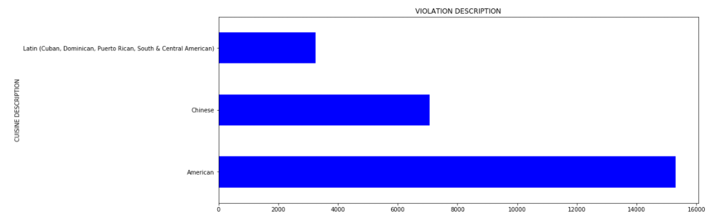

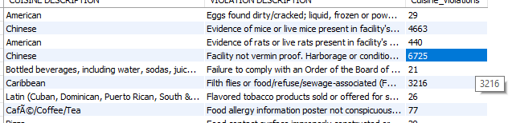
Q2 What violations each cuisine has incurred.
Data Results
Code Screenshot
Description:
These are the violations that each cuisine occurred. I also included a count on how many times they each occurred per cuisine. NULL = 1164, Chinese and American Food had the most violations.

Slide 9
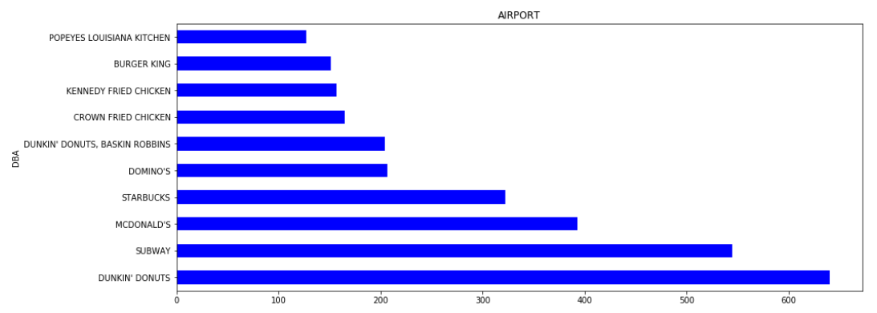
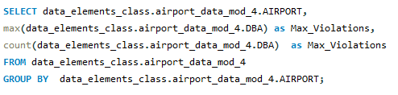
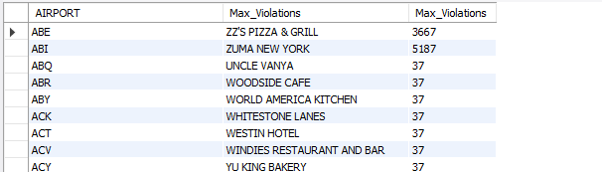
Q3 Which restaurants per airport hade more violations
Data Results
Code Screenshot
Description:
This data shows us which restaurant at which airport had the most violations and the number of violations that restaurant has had.

Slide 10

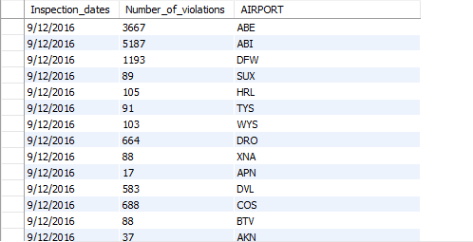
Q2 Which airports hade more violations per month
Data Results
Code Screenshot
Description: This data shows us the airports that had the most violations per each year and month of the dataset

Slide 11
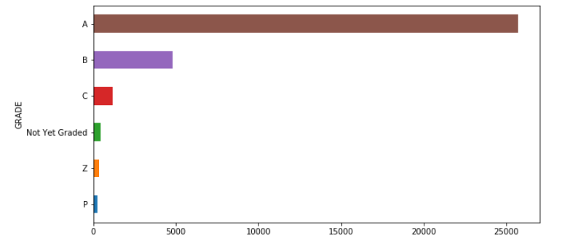
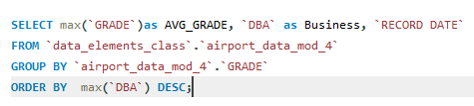
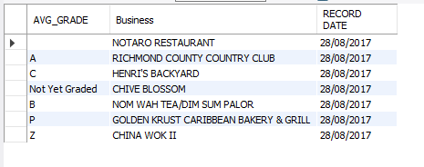
Q5: Restaurants with the most average grade
Data Results
Code Screenshot
Description: This restaurants have had the most grades meaning they have had the most inspections that ether passed of failed.

Slide 12
Conclusion Slide
Data shows us:
The data shows us that there is 57974 airports.
The minimum number of violations occurred is from WED airport.
The maximum number of violations is from ABI and NULL values.
Chinese food has the most violations i'm the most violations not having restaurants vermin proof or in suitable eating conditions.
We can see that at ABE and ABI the restaurants in Kettering more violations are Zuma's New York and ZZ's Pizza & Grill.
We can see that most violations occurred in 2016.
And we can see that Richmond County Country Club as on average the best grade in 2017 with an "A" While China Wok has the worst grade "Z".

